Slide 1
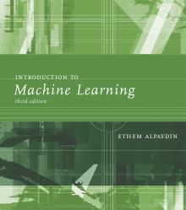
INTRODUCTION TO Machine Learning 3rd Edition
Lecture Slides for
ETHEM ALPAYDIN
© The MIT Press
alpaydin@boun.edu.tr
http://www.cmpe.boun.edu.tr/~ethem/i2ml3e

Slide 2
CS-470 Machine Learning
Detailed lecture breakdown and books to be mentioned in the course outline (LMS)
Advanced level course with the following prerequisites
Stochastic Systems
Probability Theory
General Maths
Signal/Image Processing (Optional)
Programming Skills (Matlab, C++, Python)

Slide 3
CS-470 Machine Learning
AI
ML
ANN
DL
AI: General Intelligent Systems, Decision Support Systems, ML, Data Mining,
NLP, Autonomous Robotics, Self-Aware Software Systems, Machine Vision
ML: Mathematical Algorithms for Decision Making by Machines

Slide 4
SE-807 Machine Learning
AI
ML
ANN
DL
AI: Rules and regulations
Theory to develop intelligent systems
Philosophy of intelligence
Ways to implement
Ethics governing AI
ML: General ways of impelmentation comprising any algorithm
ANN is dedicated way of achieving ML
DL is complex and highly nonlinear ANN and ANN maths

Slide 5
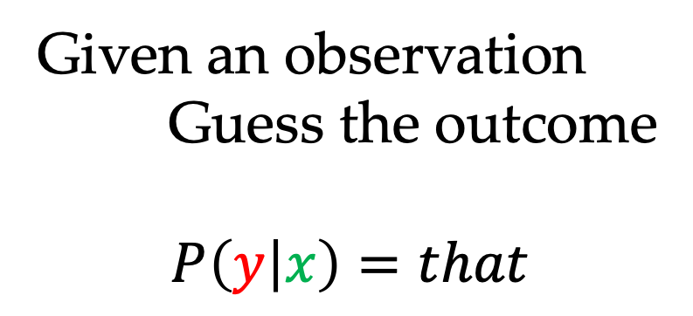
Machine Learning
if x = this
y = that
else
y = not that
Given an observation
Guess the outcome
$$P\left(y | x\right)=that$$

Slide 6
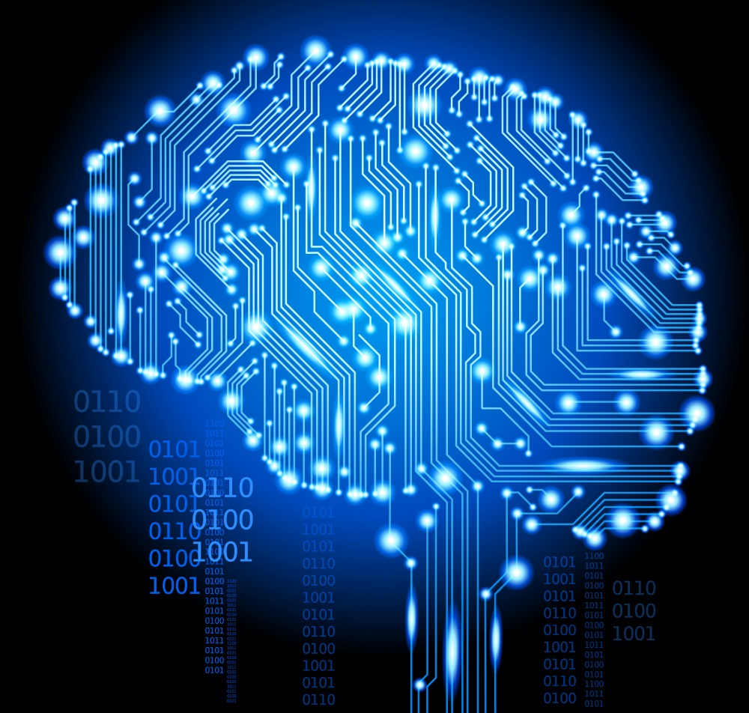
Machine Learning
if x = this
y = that
else
y = not that
Given an observation
Guess the outcome
$$P\left(y | x\right)=that$$
Not Intelligent
Intelligent

Slide 7
Machine Learning
if x = this
y = that
else
y = not that
Given an observation
Guess the outcome
$$P\left(y | x\right)=that$$
Learn to extract task-specific information, memorize and able to make estimated decision

Slide 8
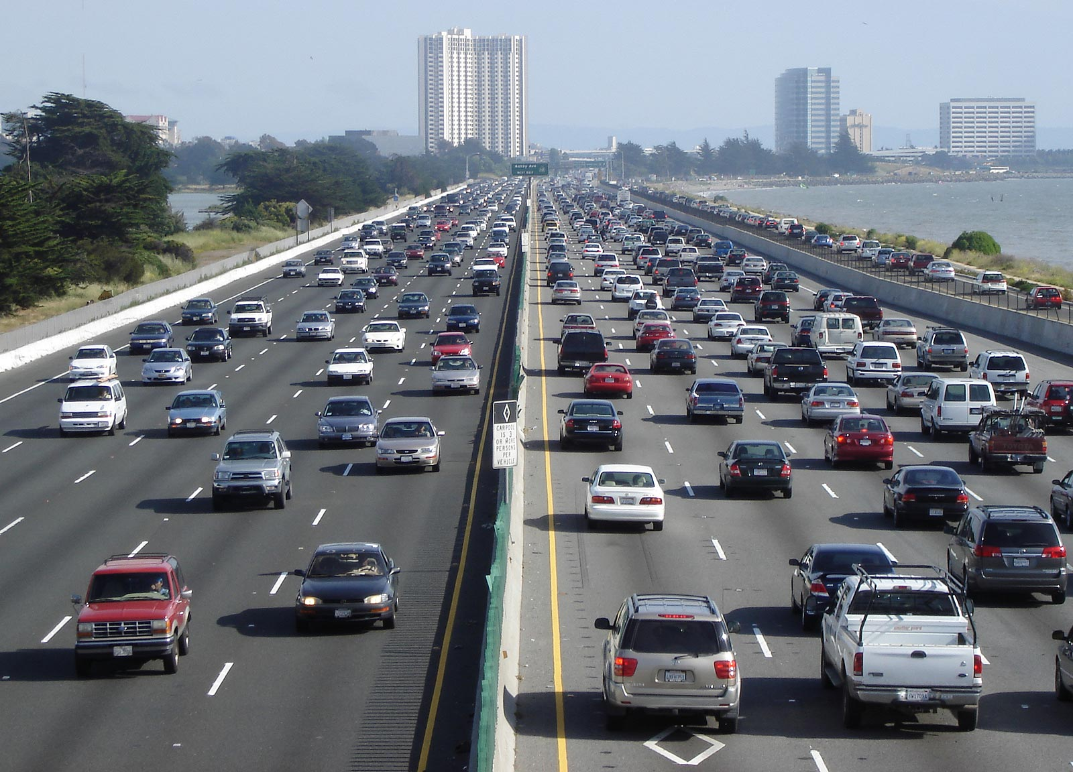
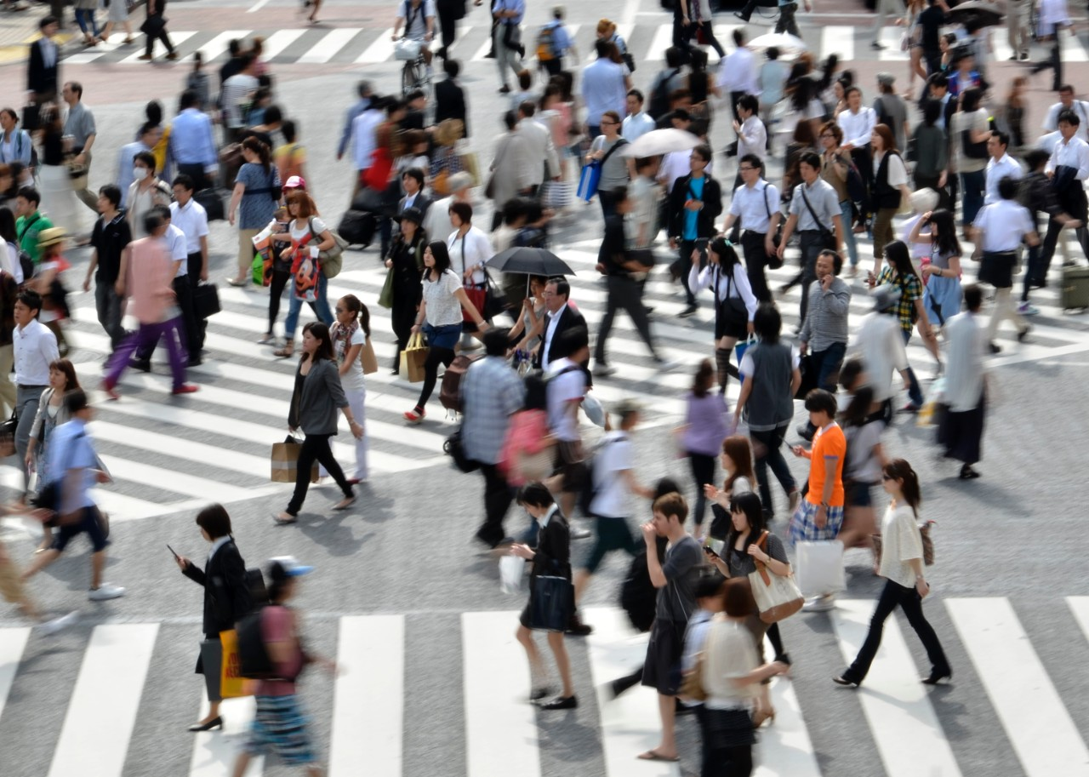

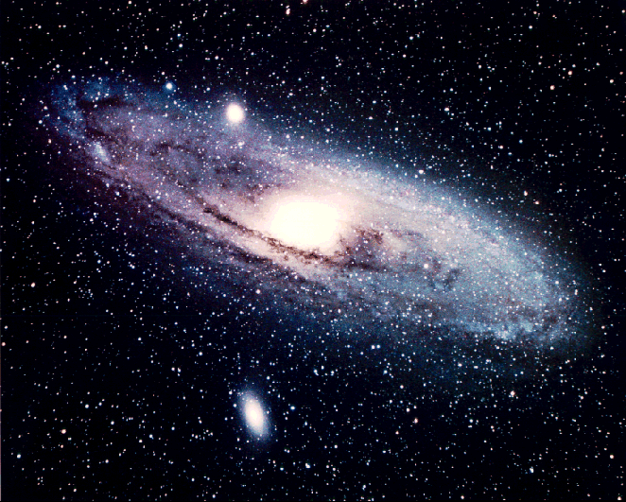


Why Machine Learning?

Slide 9
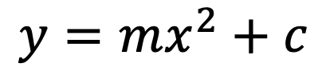
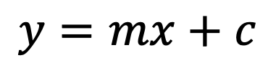
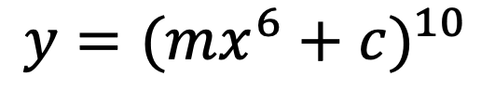
Why Machine Learning?
$$y=mx+c$$
Linear
$$y=mx^{2}+c$$
Nonlinear
$$y={(mx^{6}+c)}^{10}$$
Highly Nonlinear

Slide 10
Why Machine Learning?
$$y=mx+c$$
Linear
Direct Solution Possible
$$y=mx^{2}+c$$
Nonlinear
Direct Solution Possible
$$y={(mx^{6}+c)}^{10}$$
Highly Nonlinear
Direct Solution Not Possible --- ML

Slide 11
CHAPTER 1: Introduction

Slide 12
Big Data
Widespread use of personal computers and wireless communication leads to “big data”
We are both producers and consumers of data
Data is not random, it has structure, e.g., customer behavior
We need “big theory” to extract that structure from data for
(a) Understanding the process
(b) Learn and memorize
(b) Making predictions for the future

Slide 13
Why “Learn” ?
Machine learning is programming computers to optimize a performance criterion using example data or past experience.
There is no need to “learn” to calculate payroll
Learning is used when:
Human expertise does not exist (navigating on Venus),
Humans are unable to explain their expertise (speech recognition)
Solution changes in time (mobile communication)
Solution needs to be adapted to particular cases (user biometrics)

Slide 14
What We Talk About When We Talk About “Learning”
Learning general models from a data of particular examples
Data is cheap and abundant (data warehouses, data marts); knowledge is expensive and scarce.
Example in retail: Customer transactions to consumer behavior:
People who bought “Blink” also bought “Outliers” (www.amazon.com)
Build a model that is a good and useful approximation to the data.

Slide 15
Data Extraction
Retail: Market basket analysis, Customer relationship management (CRM)
Finance: Credit scoring, fraud detection
Manufacturing: Control, robotics, troubleshooting
Medicine: Medical diagnosis
Telecommunications: Spam filters, intrusion detection
Bioinformatics: Motifs, alignment
Web mining: Search engines
...

Slide 16
What is Machine Learning? (to sum up)
Extract information from given data.
Optimize a performance criterion using example data or past experience i.e., think how to effectively and efficiently solve the problem.
Role of Statistics: Inference (statistical modeling) from a sample
Role of Computer science: Efficient algorithms to
Solve the optimization problem
Representing and evaluating the model for inference

Slide 17
Applications
Association
Supervised Learning
Classification
Regression
Unsupervised Learning
Reinforcement Learning

Slide 18
Learning Associations
Basket analysis:
P (Y | X ) probability that somebody who buys X also buys Y where X and Y are products/services.
Example: P ( chips | cola ) = 0.7

Slide 19
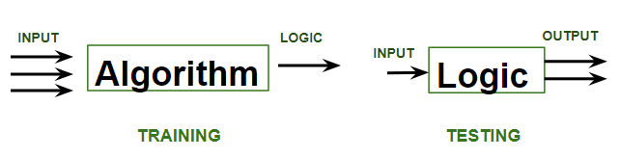
Supervised Learning
Process of learning for machines that involve guidance or teaching to achieve a solution.
For each data type, a separate label or identity is taught to the algorithm.

Slide 20
Supervised Learning: Uses
Prediction of future cases: Use the rule/logic to predict the output for future inputs or classify or identify
Knowledge extraction: The rule is easy to understand. You can directly guess the identity.
Compression: The rule is simpler than the data it explains: representation by class type or label.
Outlier detection: Exceptions that are not covered by the rule, e.g., fraud (negative examples).

Slide 21
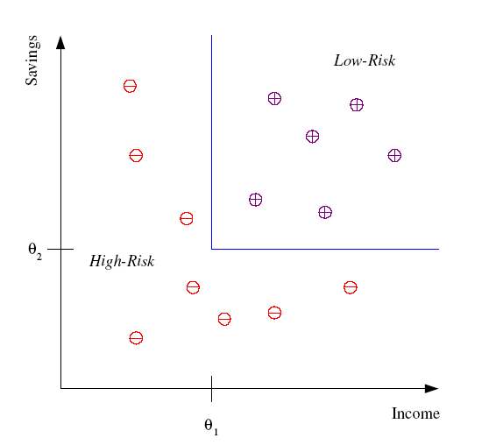
Classification
Example: Credit scoring
Differentiating between low-risk and high-risk customers from their income and savings
Discriminant: IF income > θ₁ AND savings > θ₂
THEN low-risk ELSE high-risk

Slide 22
Classification: Applications
Aka Pattern recognition
Face recognition: Pose, lighting, occlusion (glasses, beard), make-up, hair style
Character recognition: Different handwriting styles.
Speech recognition: Temporal dependency.
Medical diagnosis: From symptoms to illnesses
Biometrics: Recognition/authentication using physical and/or behavioral characteristics: Face, iris, signature, etc
Outlier/novelty detection:

Slide 23








Face Recognition
Training examples of a person
Test images
ORL dataset,
AT&T Laboratories, Cambridge UK

Slide 24
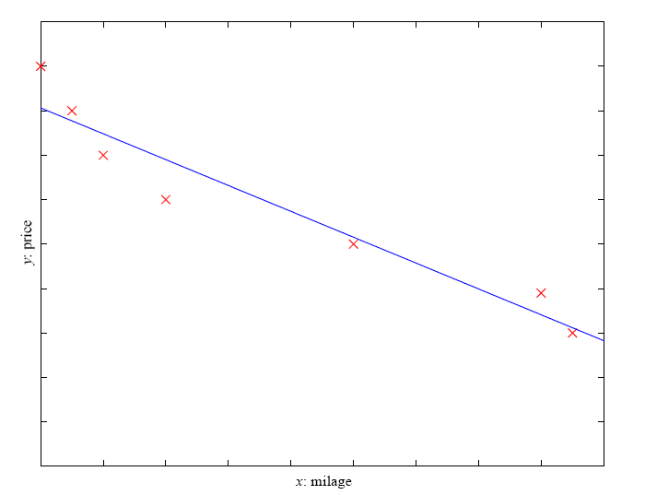
Regression
Example: Price of a used car
x : car attributes
y : price
y = g (x | θ )
g ( ) model,
θ parameters
y = wx+w₀

Slide 25
Regression
Example: Price of a used car
x : car attributes
y : price
y = g (x | θ )
g ( ) model,
θ parameters
y = wx+w₀
y = w₁x³+w₂x+w₀

Slide 26
Regression Applications
Navigating a car: Angle of the steering
Kinematics of a robot arm
(x,y)
α₁= g₁(x,y)
α₂= g₂(x,y)
α₂
α₁
Response surface design

Slide 27
Regression Applications
Navigating a car: Angle of the steering
Kinematics of a robot arm
(x,y)
α₁= g₁(x,y)
α₂= g₂(x,y)
α₂
α₁
Response surface design

Slide 28
Unsupervised Learning
Learning “what normally happens”
No output
Clustering: Grouping similar instances using matching
Example applications
Customer segmentation in CRM
Image compression: Color quantization
Quality assurance: Fruit sorting and grading

Slide 29
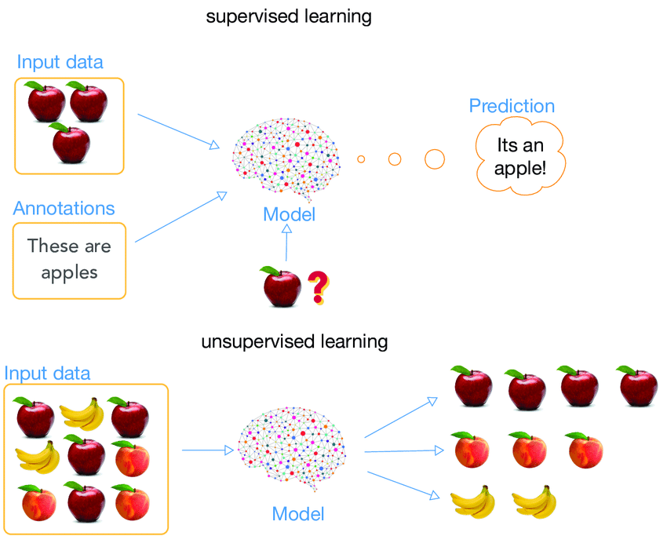
Supervised vs Unsupervised Learning

Slide 30
Reinforcement Learning
Learning a policy: A sequence of outputs
No supervised output but delayed feedback
Multiple agents, partial observability, …
Learn from pure experience
Example: game playing

Slide 31
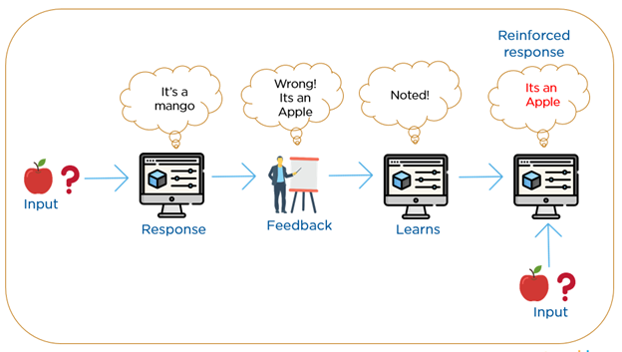
Reinforcement Learning

Slide 32
A little test
Prediction about stock market
Automatic seating plan according to age
Speaker recognition
Spam filtering
Path finding robot
Fruit sorting on conveyor belt
Recommendation software system
Optical character recognition

Slide 33
A little test
Prediction about stock market = Supervised
Automatic seating plan according to age = Unsupervised
Speaker recognition = Supervised
Spam filtering = Reinforcement
Path finding robot = Reinforcement
Fruit sorting on conveyor belt = Unsupervised
Recommendation software system = Association
Optical character recognition = Supervised

